Slide 1

October 25, 2024
Lalit Boyapati & Augustus Simanson
Predicting NBA All-Stars

Slide 2
October 25, 2024
Background
Preprocessing
Attribute Selection
Classification
Results
Analysis

Slide 3
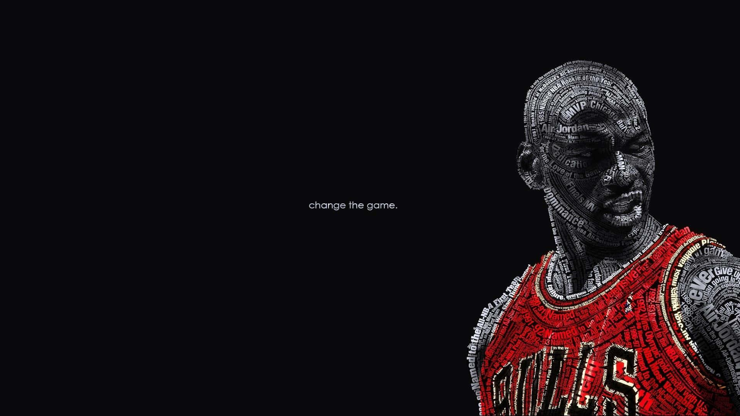
October 25, 2024
Background

Slide 4
October 25, 2024
What is our project?
NBA All-Star Selection
Research Question & Method
Goals & Impact
Every February, 24 players are chosen for the NBA All-Star Game.
Players are divided into Eastern and Western Conference.
Selection is based on voting: 50% fan vote, 25% current player vote, and 25% by NBA representatives
Can we predict which players will be named all-stars before the voting process?
Focus: Analyze data from the 2010-2023 seasons.
Use player statistics to build a predictive model for all-star designation.
Determine the most influential stats for all-star selection.
Help fans make more informed votes.
Provide players with insights into the stats they need to excel in for potential selection.

Slide 5
October 25, 2024
68
Description of Dataset
Number of Attributes
We gathered data from stats.nba.com and basketball-reference.com. Our dataset includes player statistics from 2010-2023 and identifies whether a player was named an All-Star. This data was collected by web scraping using Python to retrieve 68 attributes from each player, including points, rebounds, assists, and other performance metrics. One limitation of our dataset we would like to point out is that not many players are all-stars in the nba causing our dataset to be heavily skewed.
7190
Total Instances
538
Number of players who were all-stars

Slide 6
Notable Initial Attributes
GP: Games Played
W: Wins
L: Losses
MIN: Average minutes played a game
PTS: Average points a game
FGM: Field Goals Made on average– Any shot or tap in besides a free throw.
FGA: Field Goals Attempted - the number of field goals attempted by the player on average.
FG_PCT: Field Goal Percentage - the percentage of field goals made by the player on average.
FG3M: Three Pointers Made - the number of three pointers made by the player on average.
FG3_PCT: Three Pointer Percentage - the percentage of three pointers made by the player on average.
FT_PCT: Free Throw Percentage - the percentage of free throws made by the player on average .
OREB: Offensive Rebounds per game - the number of offensive rebounds grabbed by the player on average .
DREB: Defensive Rebounds per game - the number of defensive rebounds grabbed by the player on average .
AST: Assists - the number of assists passed by the player on average .
TOV: Turnovers - the number of turnovers caused by the player on average .
STL: Steals - the number of steals forced by the player on average .
BLK: Blocks - the number of shots blocked by the player on average .
PF: Personal Fouls - the number of personal fouls committed by the player on average .
NBA_FANTASY_POINTS: The number of fantasy points generated by the player on average.
DD2: Double-Doubles - the number of games in which a player achieves double digits in two statistical categories
TD3: Triple-Doubles - the number of games in which a player achieves double digits in three statistical categories
PLUS_MINUS: The point differential when a player is on the court.
And our class is:
All_Star_Selection: Whether or not player was named All-Star

Slide 7

October 25, 2024
Preprocessing

Slide 8
October 25, 2024
Preprocessing
Missing Attributes
No missing values; comprehensive data source.
Unrelated Attributes
We removed irrelevant attributes such as Player ID, Player Name, Nickname, Fantasy Rank, etc.
Derived Attributes
We removed calculated attributes such as Win PCT, FT PCT, etc.
SMOTE
We addressed the class imbalance mentioned in a previous slide by using SMOTE (Synthetic Minority Oversampling Technique)
Achieved a ratio of 2152 all-stars to 8804 instances (24%).

Slide 9
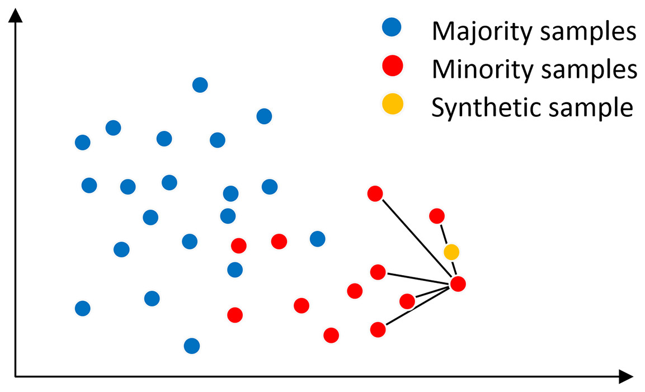

Slide 10

October 25, 2024
Attribute Selection

Slide 11
October 25, 2024
Attribute Selection Methods
CoorelationAttributeEval
This calculates the Pearson correlation coefficient between each feature and the class.
OneRAttributeEval
OneRAttributeEval in WEKA evaluates attributes by creating one-rule classifiers based on each attribute and measuring their classification error rates.
CfsSubsetEval
CfsSubsetEval works by evaluating the degree of redundancy among features associated with the class. It selects features that are highly correlated with the target variable but not correlated with each other.
Set chosen by us
Using our own prior knowledge we select attributes we believe to be the most correlated with all-star selection
InfoGainAttributeEval
InfoGainAttributeEval determines how well a given attribute separates the training examples according to their class labels. The higher the ranking means the attribute is more informative for classification.

Slide 12
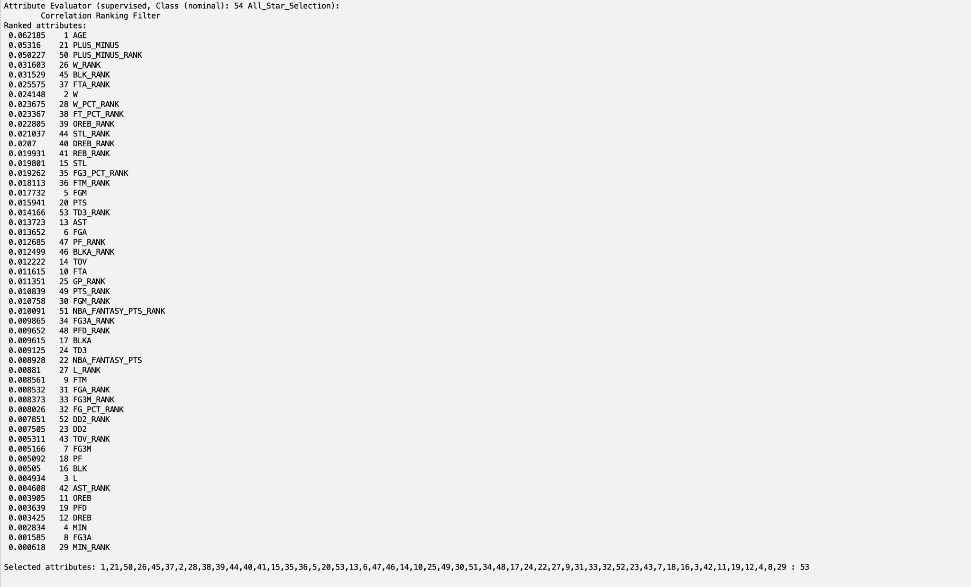
October 25, 2024
CorrelationAttributeEval
Cutoff Value of 0.02, 12 attributes
Notes:
0.2 cutoff

Slide 13
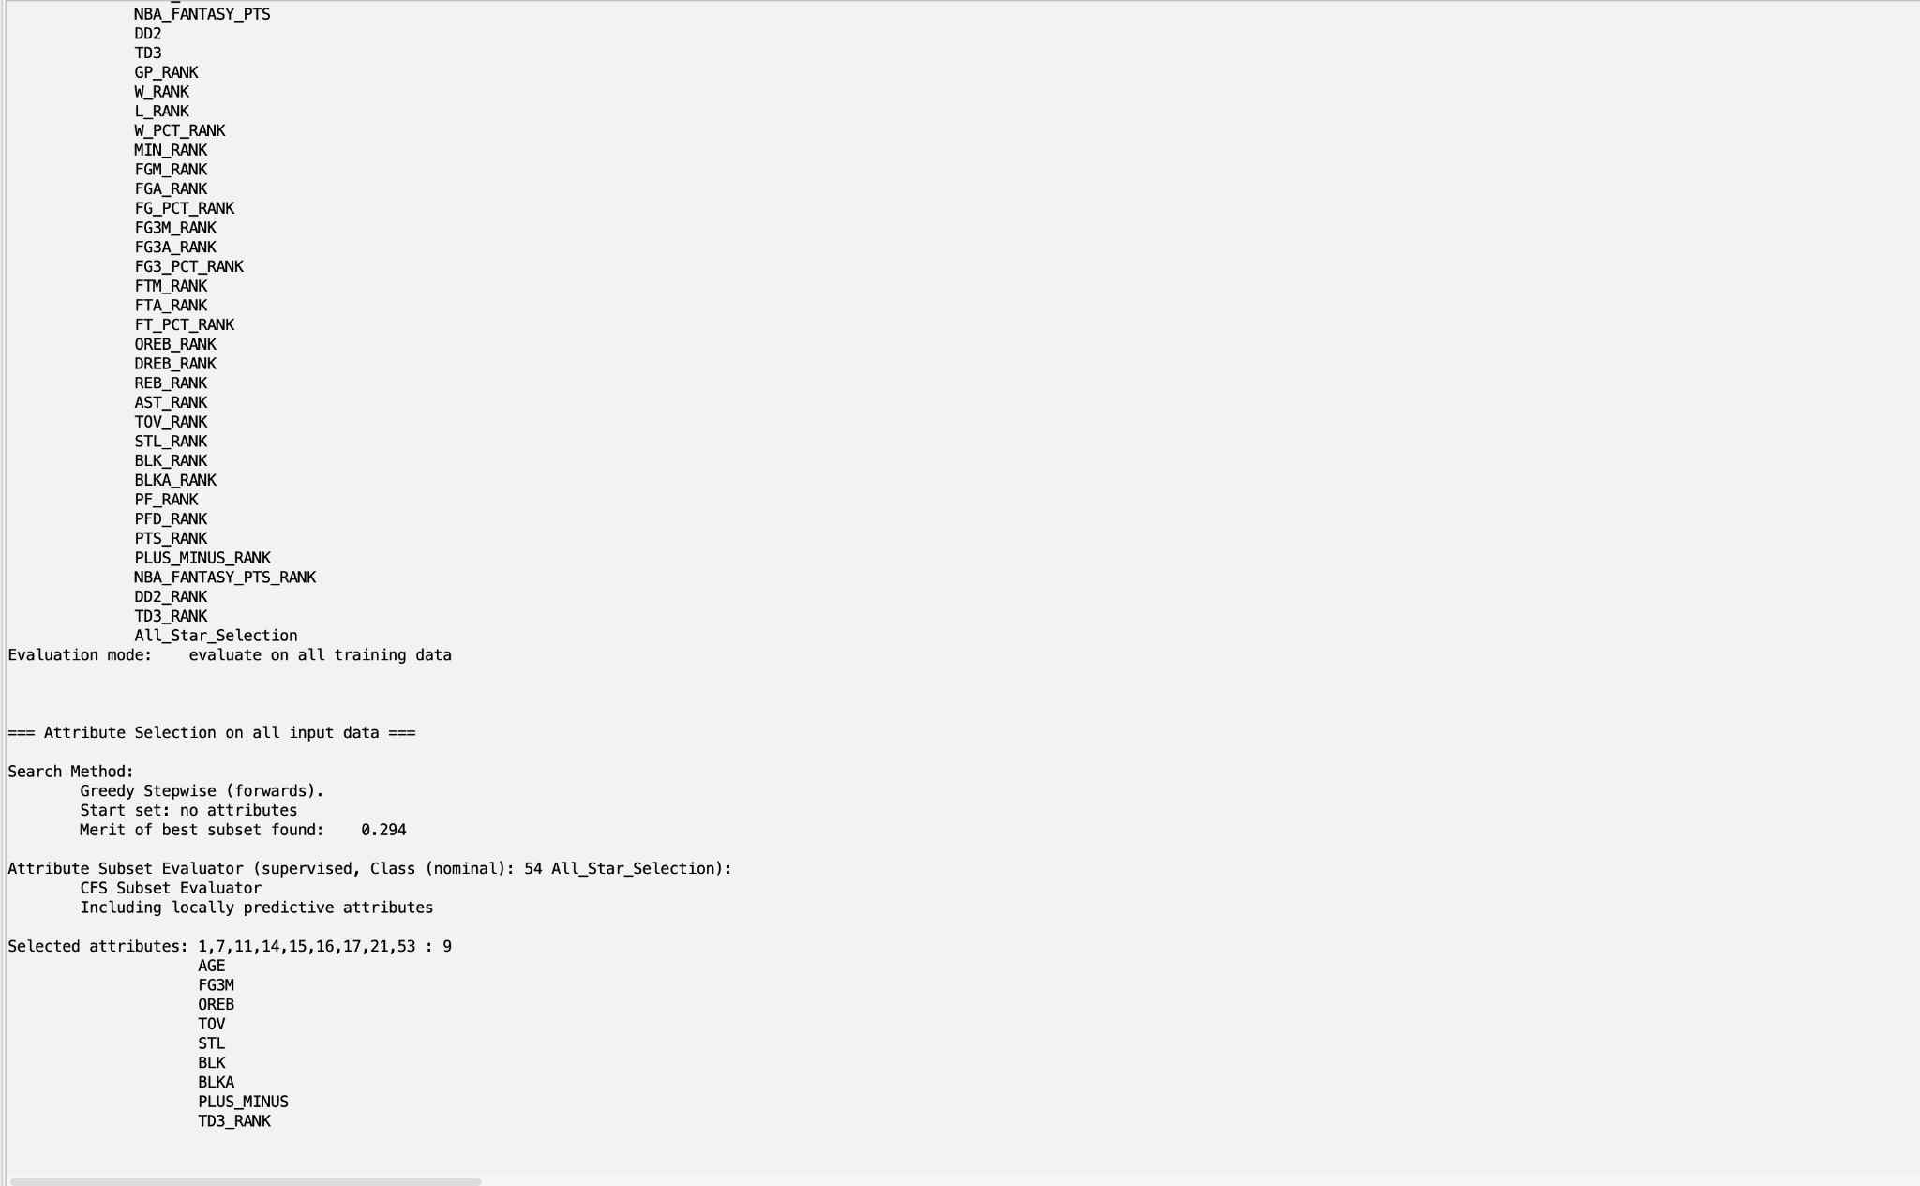
October 25, 2024
CfsSubsetEval
9 Attributes

Slide 14
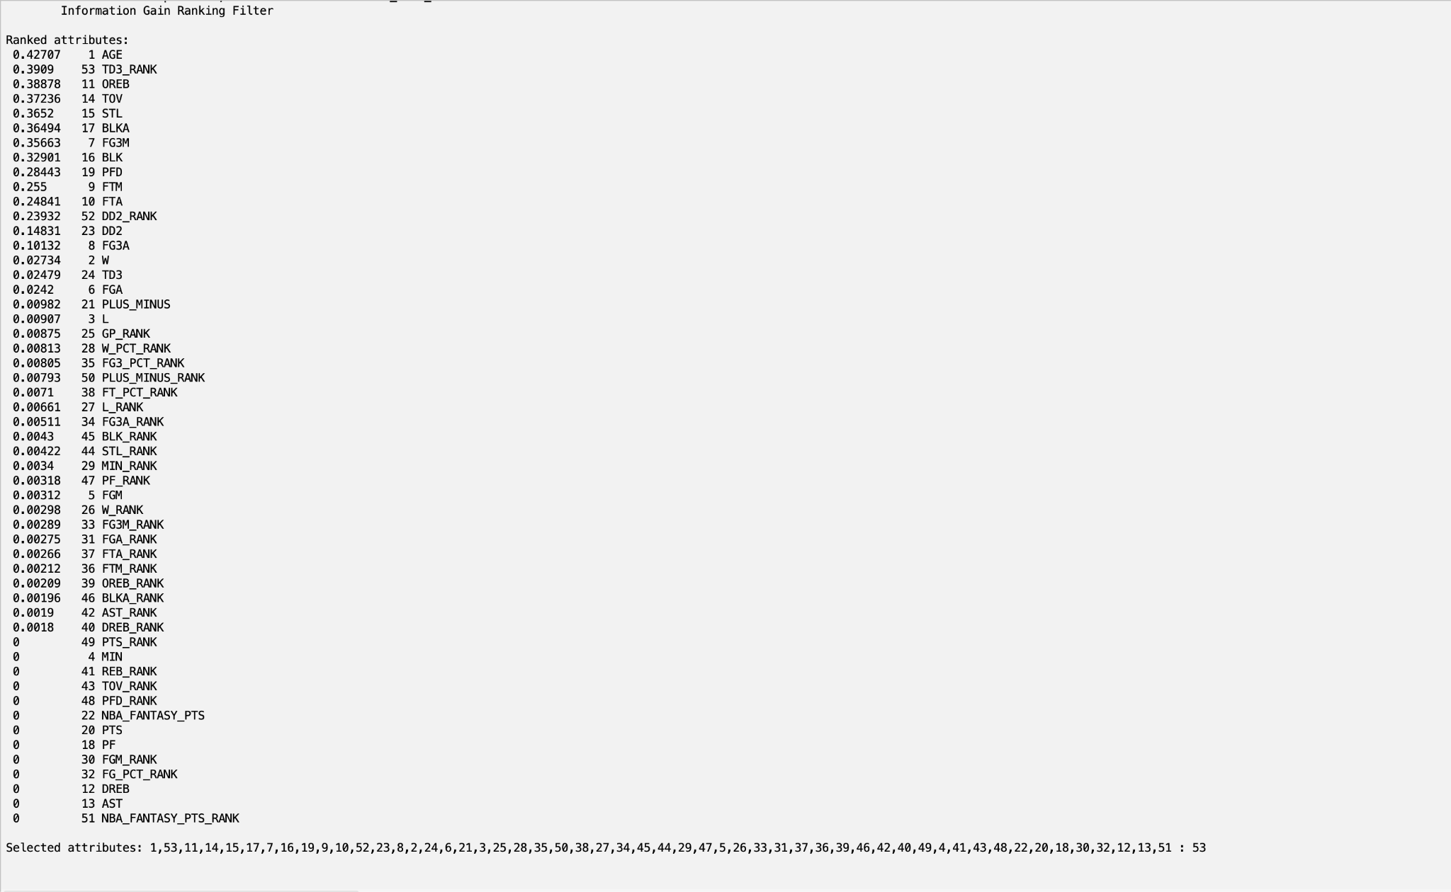
October 25, 2024
InfoGainAttributeEval
Cutoff Value of 0.2, 12 attributes
Notes:
0.2 cutoff

Slide 15
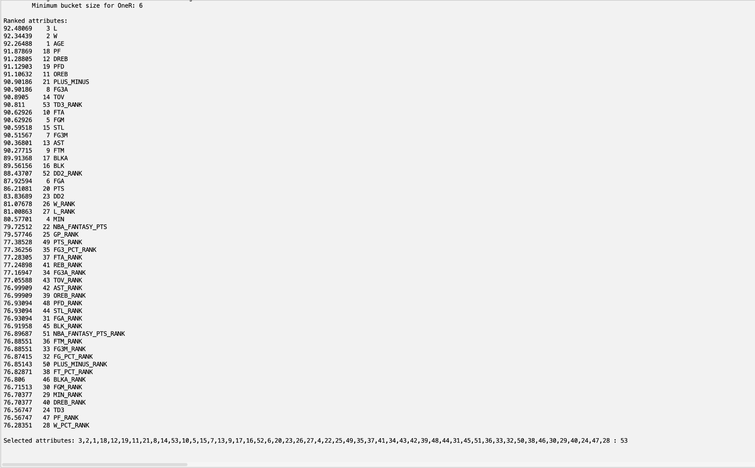
October 25, 2024
OneRAttributeEval
Cutoff Value of 90.8, 11 attributes
Notes:
90.8 cutoff

Slide 16
October 25, 2024
Set chosen by us
Based on our NBA knowledge and player performance insight we chose:
W
FGM
PLUS_MINUS
PLUS_MINUS_RANK
BLK
STL
AST
FG3M
MIN

Slide 17

October 25, 2024
Classification

Slide 18
October 25, 2024
Different Classifiers Used
Naive Bayes
A probabilistic classifier that assumes the presence of each feature is independent of the other features.
J48
A decision tree algorithm that splits the data based on attribute values. It creates tree-structures that can handle both categorical and continuous data.
OneR
A simple, rule-based classifier that generates one rule for each predictor and selects the one that performs the best.
Logistic
A statistical model used for binary classification. It assumes a linear relationship between the independent variable and the log odds of the dependent variable.

Slide 19

October 25, 2024
Results

Slide 20
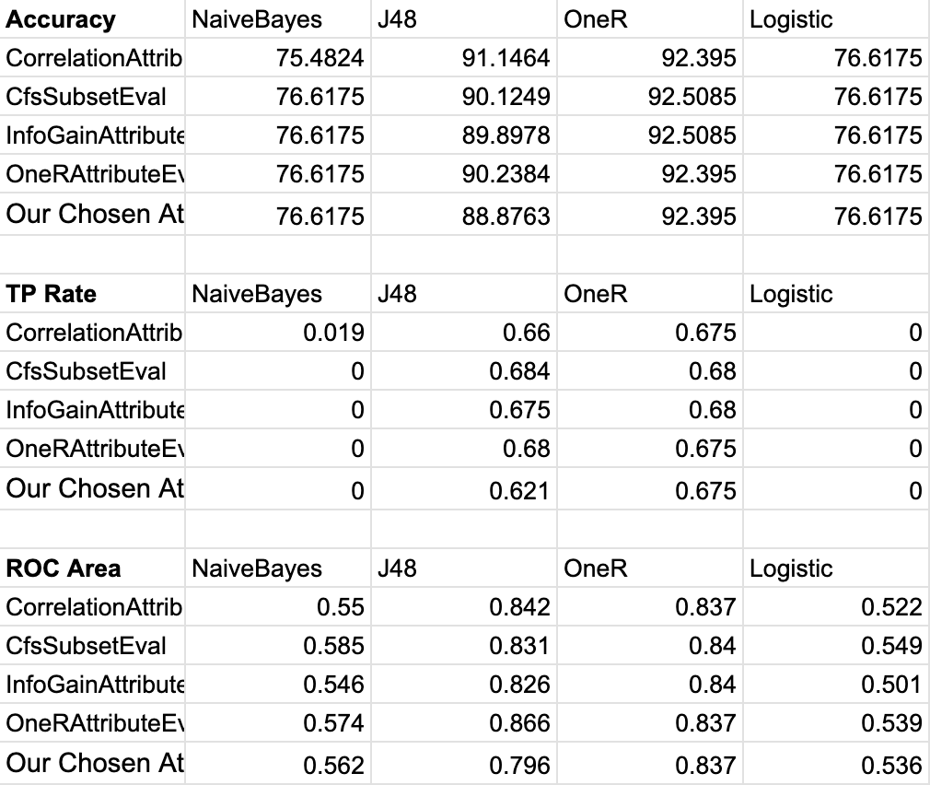
October 25, 2024
Results
Notes:
90.8 cutoff

Slide 21
Accuracy
Five Highest Accuracies:
1.CfsSubsetEval with OneR Classification - 92.5085%
1.InfoGainAttributeEval with OneR Classification - 92.5085%
2.CorrelationAttributeEval with OneR Classification - 92.395%
2.OneRAttributeEval with OneR Classification - 92.395%
2.Our Chosen Attributes with OneR Classification - 92.395%

Slide 22
TP Rate*
Five Highest True Positive Rates:
1.CfsSubsetEval with J48 Classification - 0.684
2.CfsSubsetEval with OneR Classification - 0.68
2.InfoGainAttributeEval with OneR Classification - 0.68
2.OneRAttributeEval with J48 Classification - 0.68
5. InfoGainAttributeEval with J48 Classification - 0.675

Slide 23
ROC Area
Five Highest ROC Areas:
1.OneRAttributeEval with J48 Classification - 0.866
2.CorrelationAttributeEval with J48 Classification - 0.842
3.CfsSubsetEval with OneR Classification - 0.84
3.InfoGainAttributeEval with OneR Classification - 0.84
5.Our Chosen Attributes with One R Classification - 0.837

Slide 24
Best Performing Model:
CfsSubsetEval with J48 Classification
Highest TP Rate
Strong Accuracy and ROC Area
Actual
Confusion Matrix
Classified
653 | 22
65 | 141

Slide 25

Analysis

Slide 26
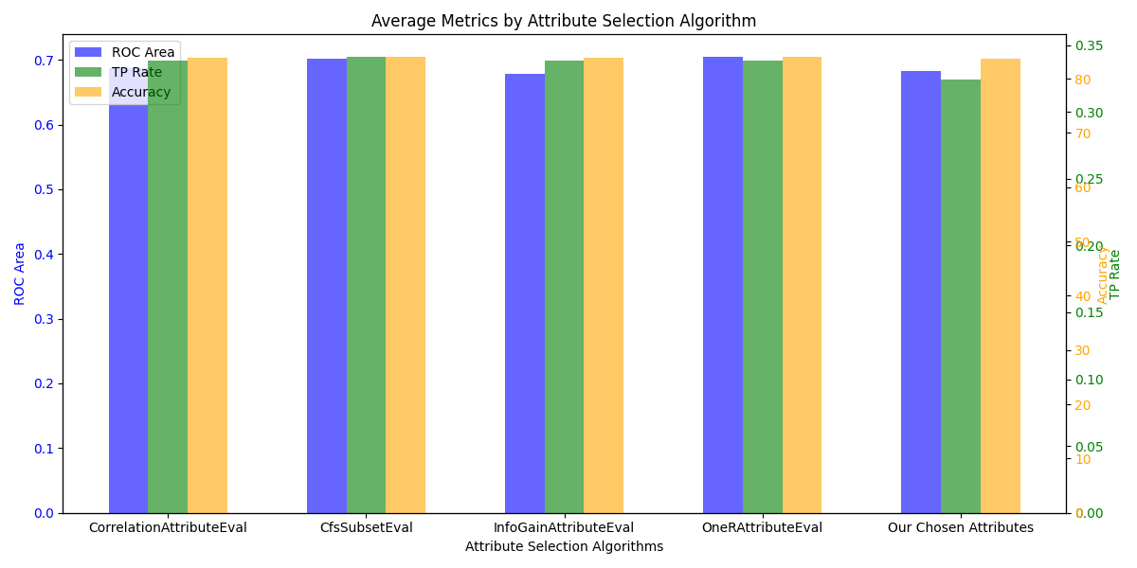

Slide 27
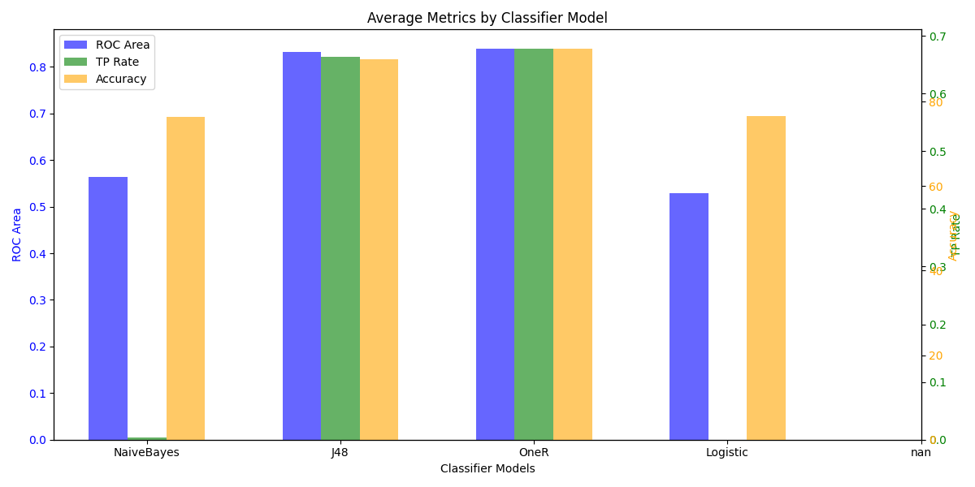

Slide 28
October 25, 2024
Key Findings
High performance of OneR
The OneR classification model consistently performs well across all attribute evaluation methods
Poor performance of NaiveBayes and Logistic Regression
both are bad with imbalanced data (not to mention feature independence)
J48’s TP Rate
J48 shows superior performance in TP rate despite not leading in accuracy
ROC Area Consistency
Models like OneR and J48 maintain a high ROC Area showing they are quite effective despite accuracy or TP rates

Slide 29
Key Findings
Attributes selected by OneR
OneR picked either Age or Wins for the rule, showing that these are the two most applicable attributes for attribute selection
Why?

Slide 30
Future Outlook
Look at advanced performance metrics, not just “traditional” statistics
Gather data prior to 2010
Use other attribute selection algorithms and classifier models (maybe even a deep learning algorithm)
Possibly expand to MVP selection, All NBA teams, ROTY, DPOY, OPOY
Explain why wins are so important

Slide 31

October 25, 2024
Thank you

